Slide 1



Smart Anti-Sleep Alert System for Drivers Using Eye Blink Detection
Team members:-V.Veera Akshay Ravee (2023peccs858 )
B.Lingesh (2023peccs874)
Dept:-Computer science and engineering
Domain:-Computer Vision
Date:-28/10/2025
Guide: DR.Therasa.M
Coordinators name :
Mr.Prabhu Shankar, Mr.Kadirvelu.G

Slide 2
ABSTRACT
Driver drowsiness is one of the leading causes of highway accidents worldwide. This project proposes a cost-effective real-time anti-sleep alert system that detects eye blinks using a webcam and OpenCV Haar cascade classifiers. If the driver’s eyes remain closed for more than 2–3 seconds, the system triggers an audio-visual alert to wake the driver. Unlike deep learning-based systems, this approach is lightweight, requires no pre-training or datasets, and works on standard hardware.

Slide 3
INTRODUCTION
Road accidents due to driver fatigue account for 20–50% of highway crashes. Existing commercial drowsiness detection systems are expensive and complex. Our project focuses on providing a low-cost and efficient real-time solution. The system uses live video, monitors eye state, and alerts drivers before accidents occur.

Slide 4
SOFTWARE/HARDWARE REQUIREMENT
Software
Language: Python
Libraries: OpenCV (face & eye detection), Pygame (audio alert)
IDE: VS Code
Hardware
Standard USB Webcam
Processor: Dual-core or above

Slide 5
EXISTING AND PROPOSED SYSTEM
Existing System
Uses infrared sensors or AI-based deep learning models.
Requires datasets, training, or costly hardware.
Not easily deployable on low-power devices.
Proposed System
Webcam-based real-time detection.
Uses Haar cascade classifiers for lightweight eye detection.
Timer logic detects prolonged eye closure (>2–3 sec).
Triggers immediate alert (beep/voice).
Simple, affordable, and practical for real-world use.

Slide 6
LITERATURE REVIEW
R. Sambathkumar et al. (2025) – Eye blink sensors for driver drowsiness detection.
Kiran Shelke et al. (2025) – Survey of real-time drowsiness detection algorithms and challenges.
Akshay Desai et al. (2025) – Comparative study of detection methods including blink and yawning detection.

Slide 7
SYSTEM DESIGN
MODULES:
Video Capture – Live feed from webcam.
Face & Eye Detection – Detects driver’s eyes using OpenCV.
Blink Monitoring – Tracks open/closed state of eyes.
Timer Logic – Checks if eyes closed >2–3 sec.
Alert System – Triggers beep/voice warning.

Slide 8
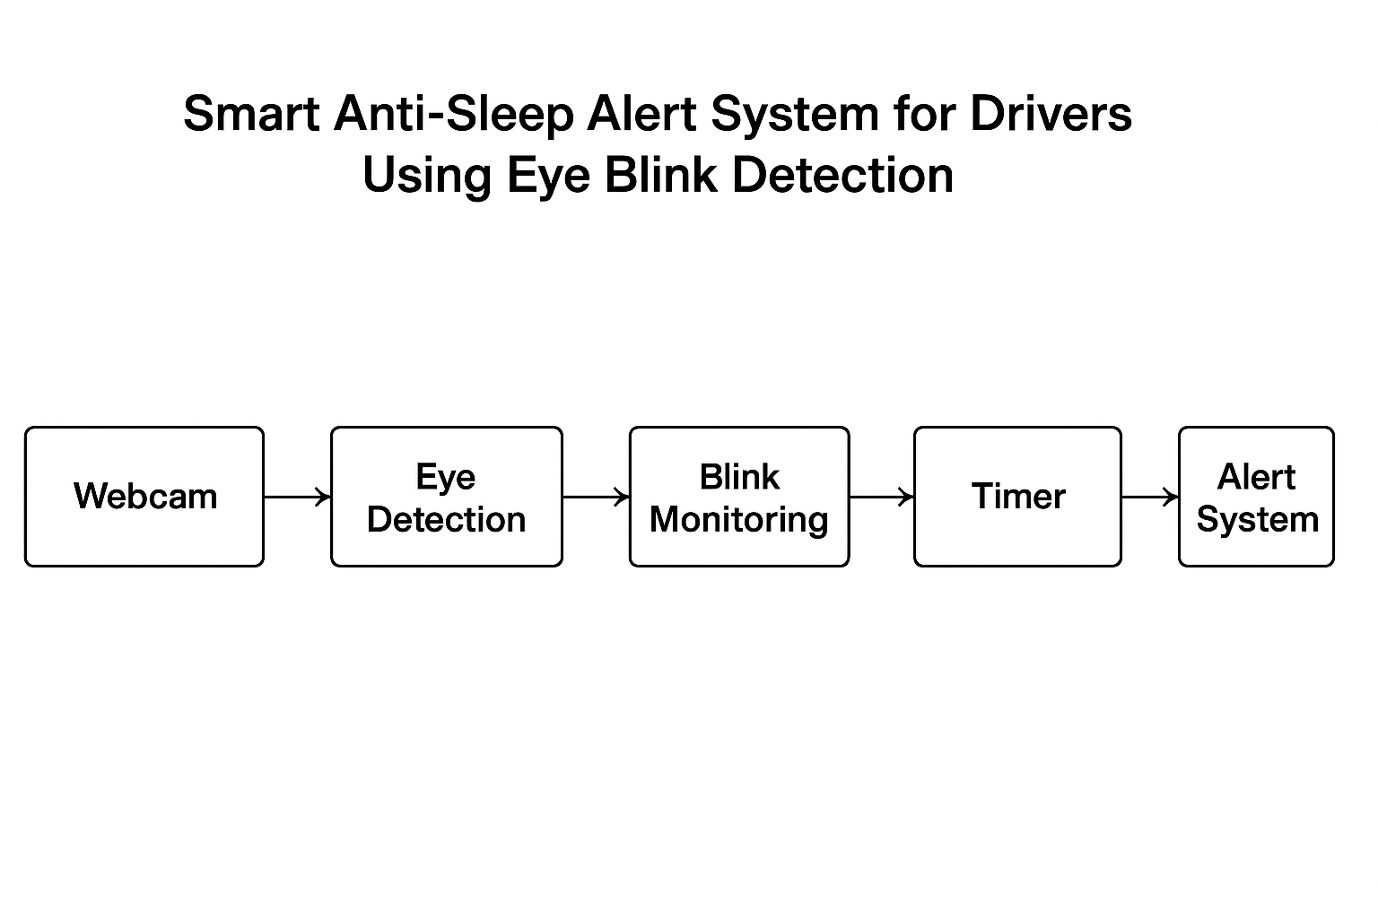
ARCHITECTURE DIAGRAM

Slide 9
IMPLEMENTATION
Import libraries (OpenCV, Pygame).
Initialize webcam for live feed.
Apply Haar cascades for eye detection.
Use timer logic for blink detection.
Generate audio-visual alert if eyes closed >3 sec.

Slide 10
TESTING
Unit Testing: Eye detection accuracy.
Functional Testing: Alert triggering when eyes closed.
Performance Testing: Real-time processing speed.
Usability Testing: Practicality in different lighting conditions.

Slide 11
CONCLUSION AND FUTURE ENHANCEMENT
Conclusion: The system provides a reliable and affordable solution for reducing drowsy-driving accidents using simple computer vision techniques.
Future Enhancements:
Add head nodding & yawning detection.
Tiered alert system (mild to strong alerts).
Integration with car dashboard for auto-braking or lane correction.
Mobile app integration for wider adoption.

Slide 12
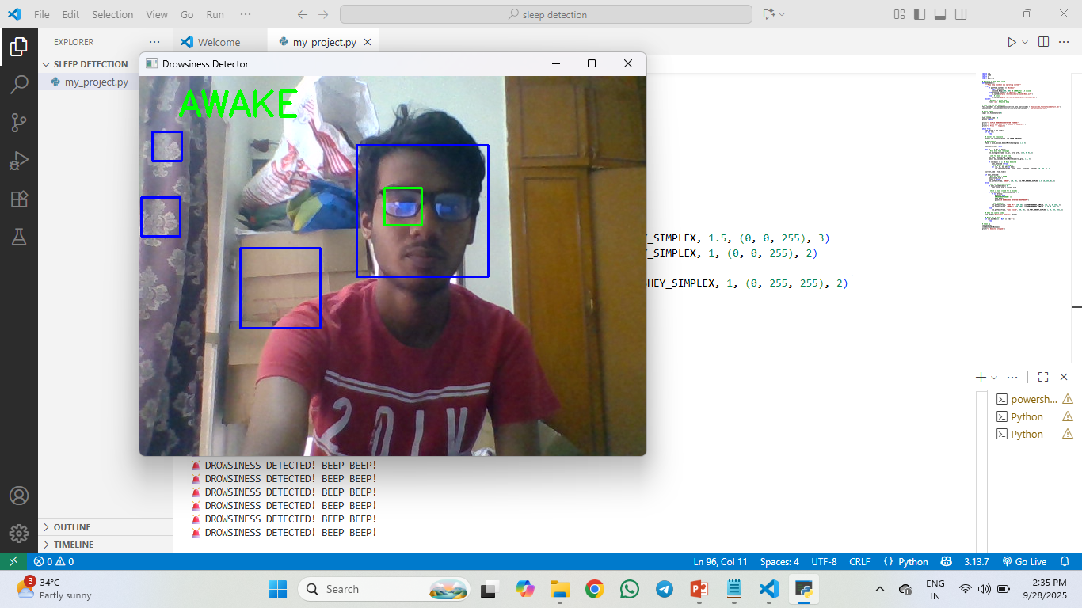
SCREENSHOT OF OUTPUT

Slide 13
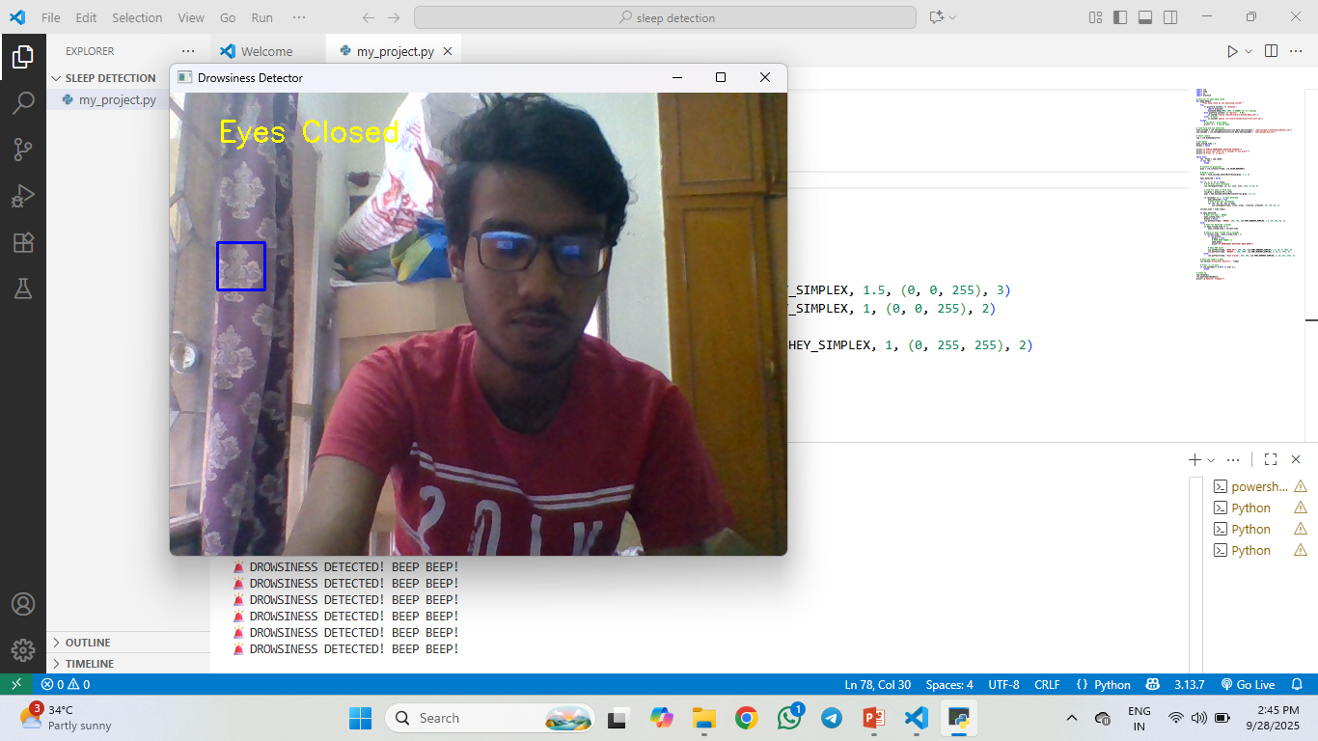

Slide 14
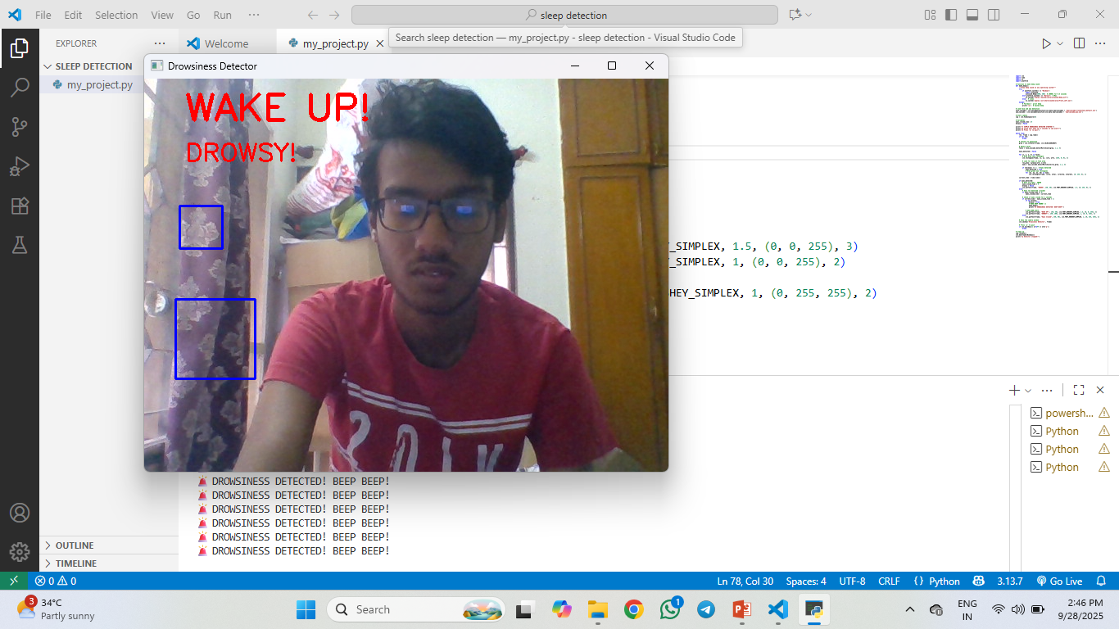

Slide 15
REFERENCE
1. R. Sambathkumar, Dr.R. Sofia, K Sivaraj, B Navinkumar, C Amarnath, A Mohamed Fazil. Detection Of Driver Drowsiness Using Eye Blink Sensor. IJCRT, 2025.
2. Kiran Shelke, Atharv Sakhare, Monika S, Dayanand Argade. Real-Time Driver Drowsiness Detection. IJMR, 2025.
3. Akshay Desai, Abhijit Korde, Shubham Patil, Nilima Warade. Driver Alert Systems: Review of Emerging Trends. JETI, 2025.
4. E. L. P. Parel, G. J. Y. Miranda, and E. M. Vergara, “Driver Drowsiness Detection Using Haar Cascade Classifier,” in Proc. 2025 Int. Conf. on Electronics, AI and Comput. (EAIC), Aug. 2025. IEEE.

Slide 16
PUBLICATION DETAILS
Conference/Journal: To be submitted in IJCRT / IJMR / JETI.
Year: 2025.
Domain: Computer Vision, AI Safety Systems.

Slide 17
THANK YOU

